Slide 1
Troubleshooting Tools
Module 3

Slide 2
Importance
Knowing how to use the right tools to solve various types of problems can save time and maximize your troubleshooting result.
The GUI, the command-line, the log files, and VMware vRealize® Log Insight can help you analyze problems and guide you toward resolution.

Slide 3
You Are Here
Course Introduction
Introduction to Troubleshooting
Troubleshooting Tools
Troubleshooting Virtual Networking
Troubleshooting Storage
Troubleshooting vSphere Clusters
Troubleshooting vCenter Server and ESXi
Troubleshooting Virtual Machines

Slide 4
Module Lessons
Lesson 1: Command Line and vSphere Management Assistant Lesson 2: Logging, Log Files, and vRealize Log Insight

Slide 5
Lesson 1: Command Line and vSphere Management Assistant

Slide 6
Learner Objectives
By the end of this lesson, you should be able to meet the following objectives:
Discuss the various methods to run commands
Discuss the various ways to access VMware vSphere® ESXi Shell
Use the VMware vSphere® Management Assistant virtual appliance
Use commands to view, configure, and manage your VMware vSphere® components

Slide 7
Methods to Run Commands
You can obtain command-line access on a VMware ESXiTM host in several ways:
vSphere ESXi Shell, which includes:
esxcli commands
A set of esxcfg-* commands: The esxcfg-* commands are deprecated in favor of the newer esxcli command-line utility.
A set of other troubleshooting commands
vSphere Management Assistant:
With the installed VMware vSphere® Command-Line Interface (vCLI) package, an administrator can carry out configuration and troubleshooting tasks.

Slide 8
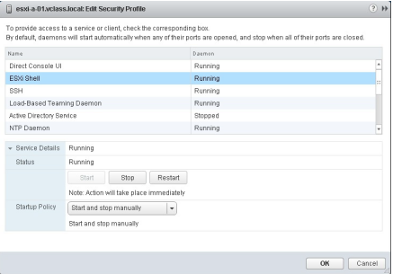
Accessing vSphere ESXi Shell
You can access vSphere ESXi Shell in different ways:
Local access by using the Direct Console User Interface (DCUI):
Enable the vSphere ESXi Shell service, either in the DCUI or vSphere Web Client.
Access vSphere ESXi Shell from the DCUI by pressing Alt-F1.
Disable the vSphere ESXi Shell service when not using it.
Remote access by using SSH:
Enable the SSH service, either in the DCUI or VMware vSphere® Web Client.
Use an SSH client, such as PuTTY, to access vSphere ESXi Shell.
Disable the SSH service when not using it.

Slide 9
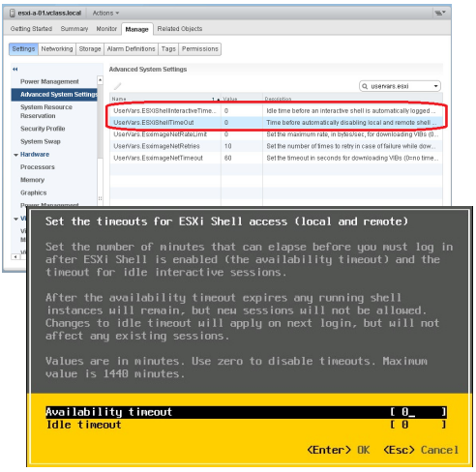
vSphere ESXi Shell and SSH Timeouts
The Availability timeout setting determines how long both the SSH and vSphere ESXi Shell remain enabled.
The Idle timeout setting, if configured, automatically logs local and remote users out if their sessions are idle for the defined period.
Both options can be configured in the DCUI when the services are disabled. In vSphere Web Client, the services must be restarted after changing these values.

Slide 10
vSphere Management Assistant Components
vSphere Management Assistant is a virtual appliance that includes components for running vSphere commands:
vCLI command set:
Enables you to run common system administration commands against ESXi hosts, such as:
• esxcli
• vmware-cmd
• vicfg-* commands
Requires credential connection options to a server
vi-fastpass authentication component:
Automates authentication to the VMware vCenter Server system or ESXi host targets.
Relieves the user from having to continually add login credentials to every command that is executed.
Facilitates unattended scripted operations.
The vifptarget command sets the target server for vCLI commands:
Entering this command changes the command prompt, which indicates the target server designation.

Slide 11
Authentication
vSphere Management Assistant can be configured to participate in Active Directory (AD) if the ESXi hosts and the vCenter Server systems are part of an AD domain:
vSphere Management Assistant can add targets without storing credentials.
AD, as a centralized solution, offers more security controls than vi-fastpass.
Follow these best practices before you configure vSphere Management Assistant for AD:
Verify that the DNS servers and vSphere Management Assistant are in the same domain.
Verify that the domain is accessible from vSphere Management Assistant.
Verify that IP addresses translate to the proper DNS name.

Slide 12
Adding vSphere Management Assistant to Active Directory
The following command adds vSphere Management Assistant to an AD domain:
sudo domainjoin-cli join domain_name domain_admin_user
The following command checks the domain settings of vSphere Management Assistant:
sudo domainjoin-cli query
The following command adds a target system for AD authentication:
vifp addserver FQDN_of_server --authpolicy adauth –-username ADDOMAIN\\user_ID
The following command removes vSphere Management Assistant from the domain:
sudo domainjoin-cli leave

Slide 13
ESXCLI Commands
The esxcli command offers options in the following namespaces:
• esxcli namespace
• esxcli fcoe namespace
• esxcli hardware namespace
• esxcli iscsi namespace
• esxcli license namespace
• esxcli network namespace
• esxcli software namespace
• esxcli storage namespace
• esxcli vm namespace
• esxcli system namespace
• esxcli device namespace
• esxcli graphics namespace
• esxcli sched namespace
• esxcli vsan namespace
• esxcli esxcli namespace
• esxcli esxcli command list for a full listing

Slide 14
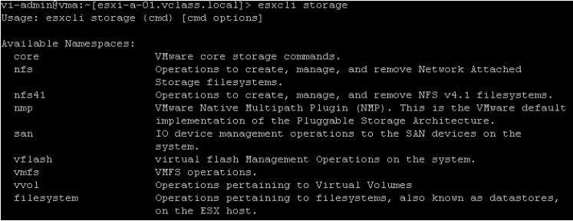
Viewing vSphere Storage Information
esxcli storage
• You use the esxcli storage command to retrieve storage information,including multipathing configuration, LUN specifics, and datastore settings.
• The esxcli storage command includes options, such as esxcli storage nfs41, esxcli storage vflash, esxcli storage vvol, and so on.

Slide 15
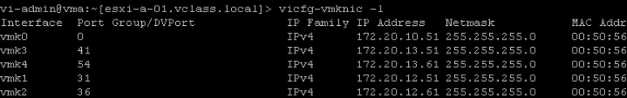
vicfg-* Commands
vicfg-*
You can use vicfg-* commands to manage your storage, network, and host configuration.
For example, you can run the vicfg-vmknic -l command to display the IP information of your VMkernel interfaces.

Slide 16
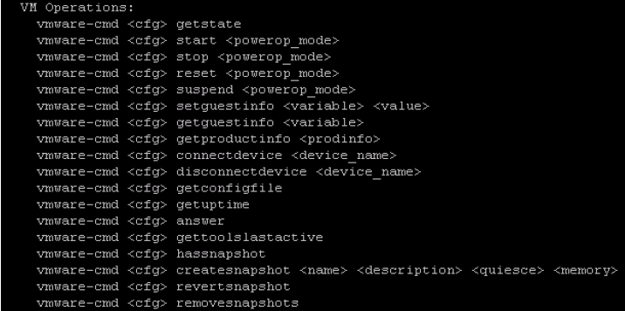
vmware-cmd Command on vSphere Management Assistant
The vmware-cmd command is used for configuring virtual machines and gathering information about them.
The vmware-cmd command can be run on vSphere Management Assistant (not available on the local or remote vSphere ESXi Shell).

Slide 17
Lab 1: Adding vSphere Management Assistant to Active Directory
Configure vSphere Management Assistant to use Active Directory
Access Your Student Desktop System
Validate the vSphere Licenses
Log In to vSphere Management Assistant
Add the vSphere Management Assistant Instance to an Active Directory Domain

Slide 18
Lab 2: Using the Command Line
Use the command line to review the vSphere configuration
Configure the Target Server
Use the more and less Commands
Use the ESXCLI Commands to Verify the Host Hardware Configuration
Use the ESXCLI Commands to Verify the Storage Information
Use the ESXCLI and vicfg-* Commands to Verify the Virtual Switch Information
Use the vmware-cmd Commands to Verify the Virtual Machine Information
Access the ESXi Host’s DCUI Locally
Access the ESXi Host’s DCUI Remotely

Slide 19
Review of Learner Objectives
You should be able to meet the following objectives:
Discuss the various methods to run commands
Discuss the various ways to access vSphere ESXi Shell
Use the vSphere Management Assistant virtual appliance
Use commands to view, configure, and manage your vSphere components

Slide 20
Lesson 2: Logging, Log Files, and vRealize Log Insight

Slide 21
Learner Objectives
By the end of this lesson, you should be able to meet the following objectives:
Find important log files
Use VMware vSphere® Syslog Collector
Gather log bundles for VMware Technical Support
Use vRealize Log Insight for log aggregation, log analysis, and log search

Slide 22
Location of vCenter Server Logs
The vCenter Server log files are on the vCenter Server system:
• Location for vCenter Server on Windows 2008/2012:
– %ALLUSERSPROFILE%\VMWare\vCenterServer\logs
• Location for VMware vCenterTM Server ApplianceTM:
– /var/log/vmware/
Subdirectories exist for vCenter Server components, such as vCenter Service, VMware vCenterTM Single Sign-OnTM, vCenter Inventory Service, and vSphere Web Client.

Slide 23
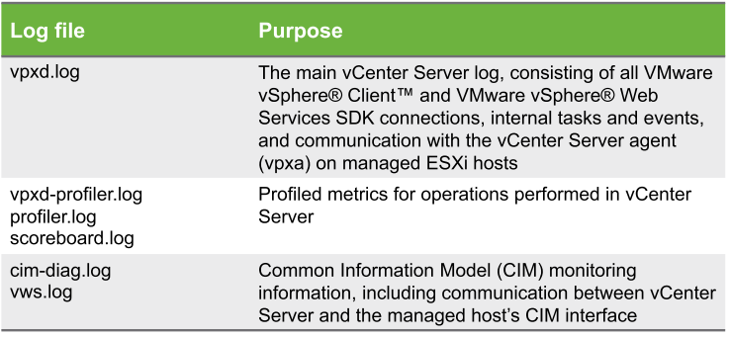
Useful vCenter Server Logs for Troubleshooting
The vpxd.log file is the main log file for vCenter Server. Most vCenter Server actions are captured in vpxd.log.
。

Slide 24
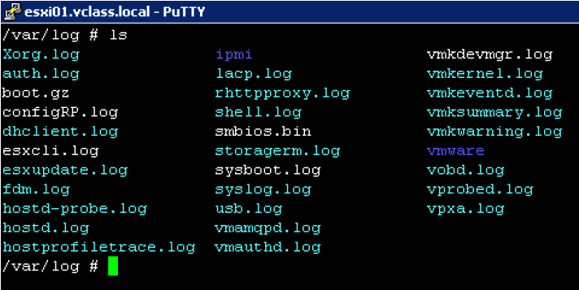
Location of ESXi Host Logs
The ESXi host log files are on the ESXi host at /var/log.

Slide 25
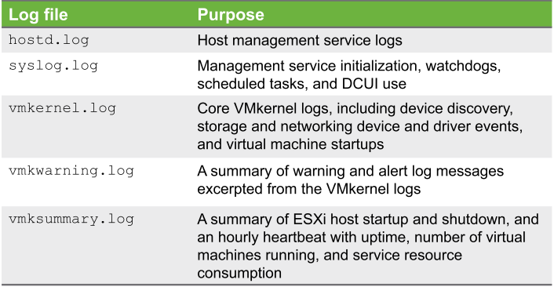
Useful ESXi Host Logs for Troubleshooting
ESXi hosts write to multiple log files, depending on which action is being performed.

Slide 26
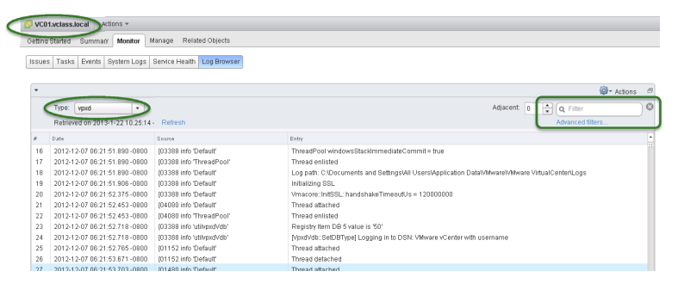
Viewing Log Files in vSphere Web Client
You can use vSphere Web Client to view and search log files on vCenter Server systems and ESXi hosts.
The log browser is on the Monitor tab for vCenter Server systems and ESXi hosts.

Slide 27
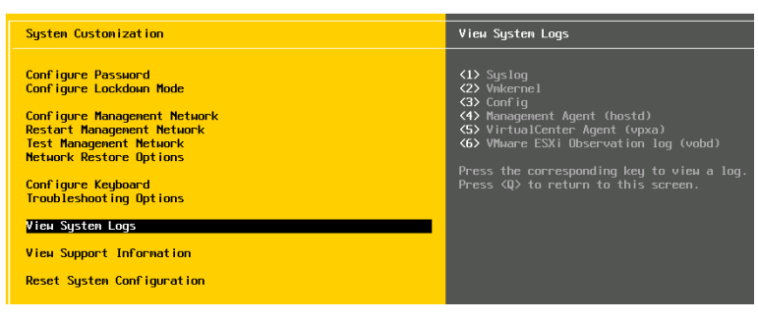
Viewing Log Files in the DCUI
You can use the DCUI to view log files if vCenter Server is not available. Only the log files for a single ESXi host can be viewed in the DCUI.

Slide 28
vSphere Syslog Collector
vSphere Syslog Collector provides a single location for all ESXi hosts to write log files.
vSphere Syslog Collector enables logs from multiple hosts to be combined and provides a structure for network logging.
vSphere Syslog Collector is preinstalled on both Windows-based vCenter Server and vCenter Server Appliance.
vSphere Syslog Collector on Windows and Sphere Syslog Service for the vCenter Server Appliance are included in the vCenter Server group of services.
By default, the vSphere Syslog Collector server uses port 514 for TCP and UDP, and port 1514 for SSL.

Slide 29
Using the vm-support Command to Export Data
You can use the vm-support command utility at the local or remote vSphere ESXi Shell to collect and compress the following types of data:
Log files
System status
Configuration files
To collect and compress useful troubleshooting data:
Run vm-support at the command line:
By default, the command does not require arguments.
The command creates a ZIP file by using the host name and a time stamp as its name:
Example: esx-esxi01.vclass.local-2013-01-23--14.09.tgz
Use the tar command to view the contents of the file:
Example: tar –tzf /var/tmp/filename

Slide 30
vRealize Log Insight
Machine-generated log data is typically massive in scale, difficult to manage, and overwhelming.
vRealize Log Insight provides a single location to collect, store, and analyze logs at scale.
vRealize Log Insight is a log management solution for physical, virtual, and cloud environments.
vRealize Log Insight helps monitor events and metrics. It analyzes root causes and performs intelligent grouping, which helps you to troubleshoot efficiently.
vRealize Log Insight provides faster analytical queries and aggregation than traditional tools, especially on larger data sets. It adds structure to all types of unstructured log data, so administrators can troubleshoot quickly.

Slide 31
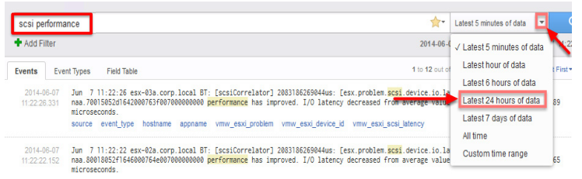
Searching and Filtering Log Events
You can search and filter log events by specifying the keywords, time range, field operations, and so on.
Event types grouping uses machine learning to group similar events together, making root cause analysis and troubleshooting faster and easier.
You can view events in context and analyze event trends to uncover anomalies.
You can also save, export, rename, share, or delete a query.

Slide 32
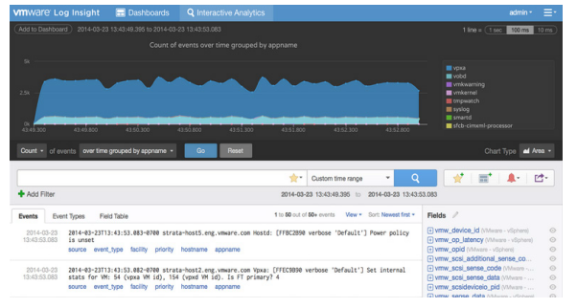
Analyzing Logs with the Interactive Analytics Charts
The charts provide visual representation of data and enable you to perform visual analysis on your query results.
You can select different chart types to graphically analyze log events.
You can modify the aggregation and grouping of query results to correlate events and make the chart meaningful for troubleshooting.

Slide 33
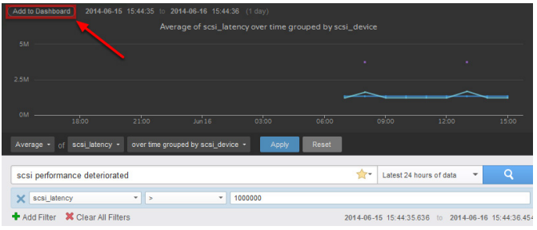
Troubleshooting Using Customized Dashboards
vRealize Log Insight Dashboards are collections of chart, field table and query list widgets.
You may customize dashboards by adding, modifying, and deleting them and tailor them to your troubleshooting needs.
For example, you can save a filtered query to your custom dashboard by creating a query list widget.

Slide 34
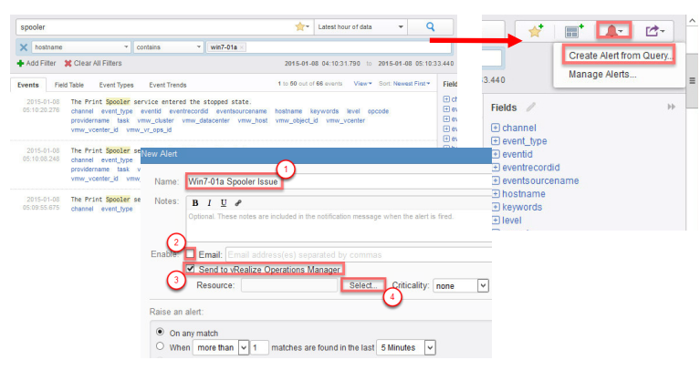
Monitoring Log Events and Sending Alerts
You can run specific alert queries at scheduled intervals. When the query exceeds the preconfigured threshold, alerts can be sent to your email or VMware vRealize® Operations Manager.

Slide 35
Lab 3: Searching Log Files
Search log files for events
Modify the vSphere Environment
Extract Log Files from vCenter Server
Search Log Files for Event Information
Clean Up for the Next Lab

Slide 36
Review of Learner Objectives
You should be able to meet the following objectives:
Find important log files Use vSphere Syslog Collector
Gather log bundles for VMware technical support
Use vRealize Log Insight for log aggregation, log analysis, and log search

